Slide 1
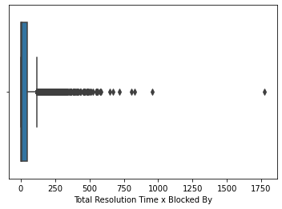
Analysis of TRT for Concerning regions
We see that there are many cases where the time taken for resolution is very high.
To understand such cases we have to take those outlier data points and deep dive into those regions.We use seaborn library for that purpose.
sns.boxplot(data['Total Resolution Time x Blocked By'])

Slide 2
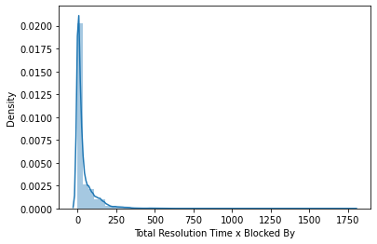
The outliers can be specidifed by Percentiles
We look at the percentile value to understand which segment of data points to consider.
We consider the data point above 70th percentile
higher_trt=data[data['Total Resolution Time x Blocked By']>30]
0th percentile :- 0.0
10 percentile :- 1.09
20 percentile :- 1.81
30 percentile :- 2.83
40 percentile :- 4.6
50 percentile :- 7.9399999999999995
60 percentile :- 23.02
70 percentile :- 30.39
80 percentile :- 66.876
90 percentile :- 119.46500000000006

Slide 3
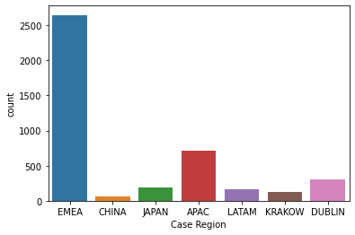
Regions for which these high TRT occur
As we can see EMEA,APAC ,DUBLIN and JAPAN are the regions we need to be focussed on.
The dataset also consists of many regions where the values are missing.
For those specific regions we need to understand the how do we impute them.

Slide 4
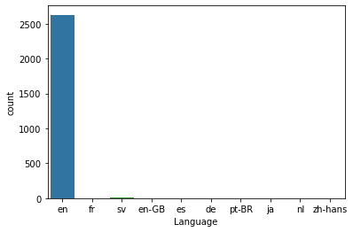
Imputing Missing regions using language as Support
We impute the missing values of the high TRT data points with EMEA.The region being the language specified to those were English.Out of the 4 regions we are concerned with EMEA is the region where the count of English language was high.
sns.countplot(higher_trt[higher_trt['Case Region']=='EMEA'].Language)

Slide 5
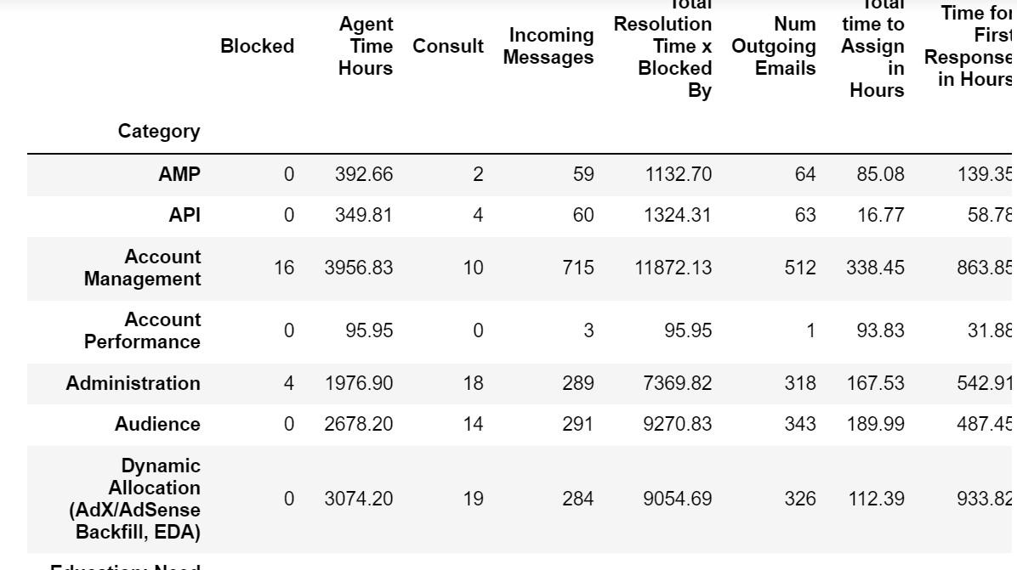
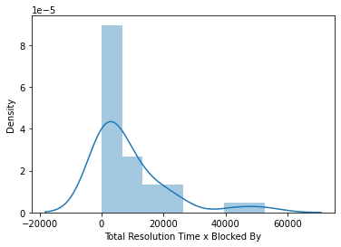
Analysis of EMEA Region
The dataset that we have,we take only those data points where the region is EMEA.
emea_df=higher_trt[higher_trt['Case Region']=='EMEA']
For this specific dataset we look at TRT.

Slide 6
Deeping Dive into EMEA High TRT
We need to see the percentile value of TRT to filter out the odd cases causing this number.
0th percentile:-40.93
10th percentile:-78.75
20th percentile:-241.56
30th percentile:-549.94
40th percentile:-1492.29
50th percentile:-4287.72
60th percentile:-7082.29
70th percentile:-9285.55
80th percentile:-14851.29
90th percentile:-22893.56
We take TRT greater than 40 percentile
category_df_taking_long=emea_cat[emea_cat['Total Resolution Time x Blocked By']>4000.

Slide 7
Categories that affect high TRT
'Account Management',
'Administration',
'Audience',
'Dynamic Allocation (AdX/AdSense Backfill, EDA)',
'Formats & Creative Trafficking',
'Inventory Management',
'Measurement',
'Native',
'Order & Line Item Delivery (Adserving)',
'Order & Line Item Setup',
'Policy',
'Programmatic Direct (Deals)',
'Publisher Controls',
'Reporting',
'Tagging',
'Video',
'XSM',
'Yield Management'

Slide 8
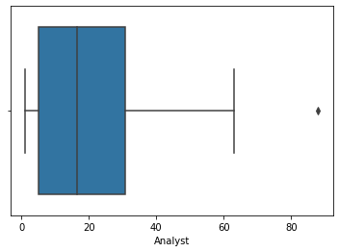
Analysts Causing high TRT
sns.boxplot(emea_df_category_hightrt.Analyst.value_counts())
This boxplot shows that if we club Analyst for this very high TRT we see that there are some analysts whose high TRT cases are more.
After finding the percentiles we take those analysts who is greater than 80 percentiles.

Slide 9
Analysts responsible for Higher TRT in EMEA Region
'nwalnekar',
'djavvaji',
'tpadala',
'vinjamuriki',
'bpullivarthi',
'sranjithkumar',
'mbano',
'mimohammed',
'pbharathi',
These Analysts are tagged with those categories which are taking more time and is for EMEA Region.
akulaaditya',
'sandepudiv',
'vbandlapalli',
'konerub',roshnim',
'sunitam',
'mnoman',
'abandela',
'vsantosh',
'pandrac',
'shaikasfiya',
'pbuyankar',
'erepalli',
'divyadas',
'shreyasgupta

Slide 10
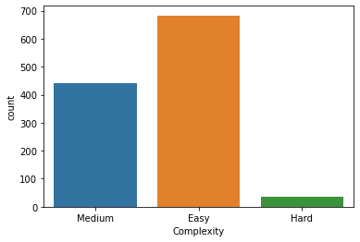
Complexity of high TRT cases assigned to the under performing Analysts
cat_analyst_high_trt=emea_df_category_hightrt[emea_df_category_hightrt['Analyst'].isin(analysts_performing_weak)]
This is an important indicator that there isn’t any Complexity factor for the cases that were appointed to those specific Analysts.

Slide 11
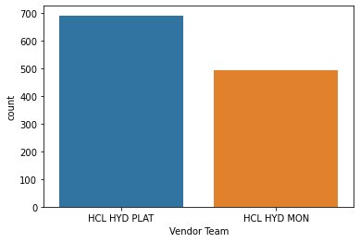
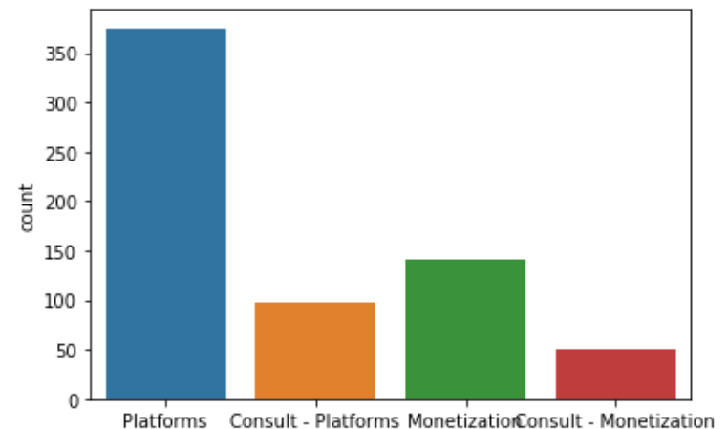
Vendor team that are underperforming
This graph clearly states for those specific categories having high TRT time and for the specific analysts taking more time they belong to either HCL HYD PLAT or HCL HYD Mon Vendor Team.

Slide 12
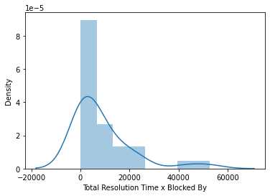
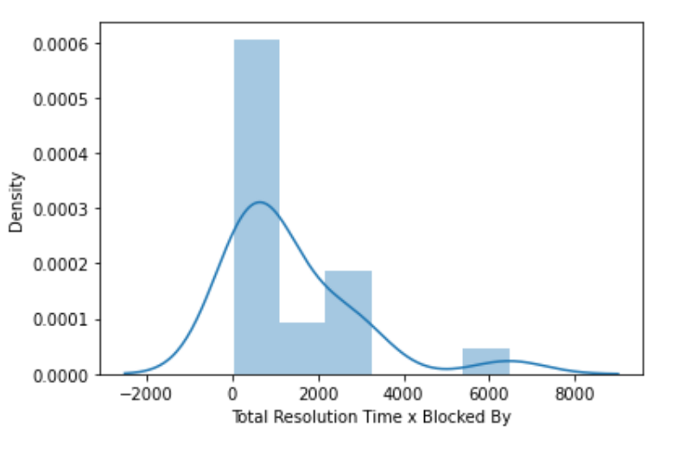
Analysis of APAC and Dublin Region
Lets look at the distribution plot of both the APAC and Dublin Region TRT cases.
As we can see both these regions have cases where TRT is very high

Slide 13
Categories of APAC and DUBLIN Region which are taking very long TRT
APAC:-
Account Management',
'Administration',
'Audience',
'Dynamic Allocation (AdX/AdSense Backfill, EDA)',
'Formats & Creative Trafficking',
'Native',
'Order & Line Item Delivery (Adserving)',
'Order & Line Item Setup',
'Policy',
'Programmatic Direct (Deals)',
'Publisher Controls',
'Reporting',
'Tagging',
'Video'
DUBLIN:-
Dynamic Allocation (AdX/AdSense Backfill, EDA)',
'Formats & Creative Trafficking',
'Measurement',
'Policy',
'Programmatic Direct (Deals)',
'Publisher Controls',
'Reporting',
'Tagging',
'Video'

Slide 14
Analysts underperforming from APAC and EMEA
koduganti
jkunjumon
msaheb
zahmedkhan
tbhavana
vpothakamuri
anuragkumarr
domar
karepe
akoushik
vajjalwar
Complexities of cases from APAC and Dublin seems almost the same.
For both the regions APAC and Dublin the complexities were Easy followed by Medium.

Slide 15
Categories with high TRT that are present in EMEA,APAC and Dublin
Dynamic Allocation (AdX/AdSense Backfill, EDA)
Formats & Creative Trafficking
Policy
Programmatic Direct (Deals)
Publisher Controls
Reporting
Tagging
Video

Slide 16
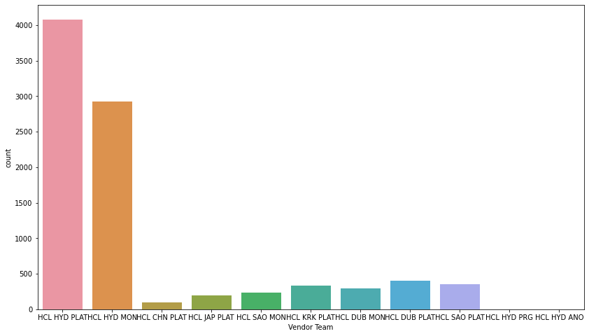
Vendors which are reason for the high TRT across all Regions
import matplotlib.pyplot as plt
plt.figure(figsize=(14,8))
sns.countplot(data[data['Category'].isin(high_trt_categories_across_all)]['Vendor Team'])
As observed the Vendors which are mostly responsible for high TRT are HCL HYD PLAT and
HCL HYD MON

Slide 17
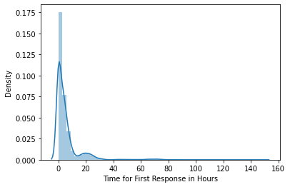
Customer Time response for the high TRT categories and agents
For the above specific regions,analysts,PM and categories it is also observed that the Time for First response is also high beyong 50th percentile

Slide 18
Recommendations
As we have observed Dynamic Allocation (AdX/AdSense Backfill, EDA),Formats & Creative Trafficking,Policy,Programmatic Direct (Deals),Publisher Controls,Reporting,Tagging,Video categories needs more focus.
3 regions need more focus as they are the point of concern for high TRT:- (EMEA,APAC and DUBLIN)
2 Vendors needs immediate attention as they are the reason for the high TRT:-HCL HYD PLAT and HCL HYD MON.
The following vendors and their respective PM needs to be assessed for high TRTs:-koduganti,jkunjumon,msaheb,zahmedkhan,tbhavana,vpothakamuri,anuragkumarr,domar,karepe,akoushik,vajjalwar.
Apart from these recommendations it is also observed that cases opened or closed through mails takes the most time to closure.So needs to be more proactive on emails rather than phone and chats.

